Slide 1

Thinking big (and critically) about qualitative research
Trends, Visions and Challenges for the Future (of Qualitative Social Science)
Lynda Cheshire School of Social Science, The University of Queensland, Brisbane, Australia
Plenary address to the 5th Biennial ACSPRI Social Science Methodology Conference
University of Sydney, 19th-22nd July 2016

Slide 2
Defining Qualitative RESEARCH
Three Paradigms
Hermeneutics and the art of interpretation – the social world can only be understood
Phenomenology – understanding phenomena from the actor’s point of view regardless of its ethics or rationality
Microsociology from the Chicago School of Sociology – the primordial focus of social inquiry should be what people do

Slide 3
Four ‘turns in qualitative research (Lather, 2013)
Qual 1.0
Conventional interpretivist inquiry: emphasis on the ‘humanistic subject who has an authentic voice, transparent descriptions of lived experience, and the generally untroubled belief that better methods and richer descriptions can get closer to the truth’ (2014: 635).

Slide 4
Qual 2.0
Qualitative research becomes ‘centred, disciplined, regulated, and normalized as qualitative handbooks, textbooks and journals create “moments” and “designs”, and fix “the research process” so that it becomes possible to know it in advance, for example, to offer a sequence of courses on qualitative inquiry, to teach someone how to “do a phenomenology”, and to teach someone how to analyze qualitative data (Lather, 2013: 635).
… Qualitative methodology has become a recognizable structure, a discursive and material formation with its own rules and regularities for producing objects of knowledge, including people. Following Foucault (1971/1972), one might conclude that it had reached the threshold of a positivity that was ‘accepted, institutionalized, [and] transmitted’ (Pierre, 2014: 6).

Slide 5
Qual 2.0. The rules and regularities of producing qualitative knowledge (Schwandt, 1991)
Maintaining the opposition of subjectivity and objectivity (i.e. acknowledging the world is made up of subjective meaning but believing researchers can disengage from that world and study it in an objective manner).
Drawing a line between the object of investigation and the investigator, as if the researcher can stand outside the world of which he or she is part to conduct an objective study of it.
Distinguishing between facts and values – investigating meaning and value in a value-free manner.

Slide 6
Basic Rules for Scientific Qualitative Research
Construct falsifiable theories (choose theories that could be wrong then test them)
Build theories that are internally consistent (if two hypotheses in your theory contradict one another, it can’t be upheld)
Dependent variables should be dependent
Do not select observations based on the dependent variable so the dependent variable is constant
Maximise concreteness (avoid unobservable concepts)
To make theory falsifiable, choose one that has as many observable implications as possible
To better evaluate theory, collect data on as many observable implications as possible
The more evidence we can find in varied contexts, the more powerful our explanation becomes
State theories that are as encompassing as possible
All data and analyses should, insofar as possible, be replicable.
King, Keohane and Verba (1994) Designing Social Inquiry: Inference in Qualitative Research.

Slide 7
Seeing Qualitative Research Through the Logic of Science
… that the research was only undertaken in Queensland limits the generalisability of the findings to Queensland and not the rest of Australia, but further research could be conducted in other states in the future.
The ‘uniqueness and non-typicality’ of the two case study sites, along with the qualitative methodology, limit the application of the research findings. To address this, I recommend the use of survey research in the future to generate research data that has broader applicability.
this study is not a cross-sectional collection of data to generalise the findings of immigrants’ settlement experiences beyond the immediate research site …

Slide 8
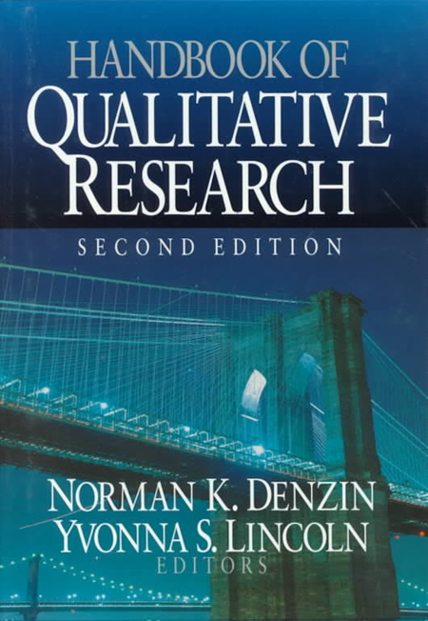
Qual 3.0
Poststructuralist rejection of scientific concepts for organising and assessing qualitative research:
Triangulation
Writing
Field Site
Transcription

Slide 9

THE neoliberal research environment and qualitative research

Slide 10
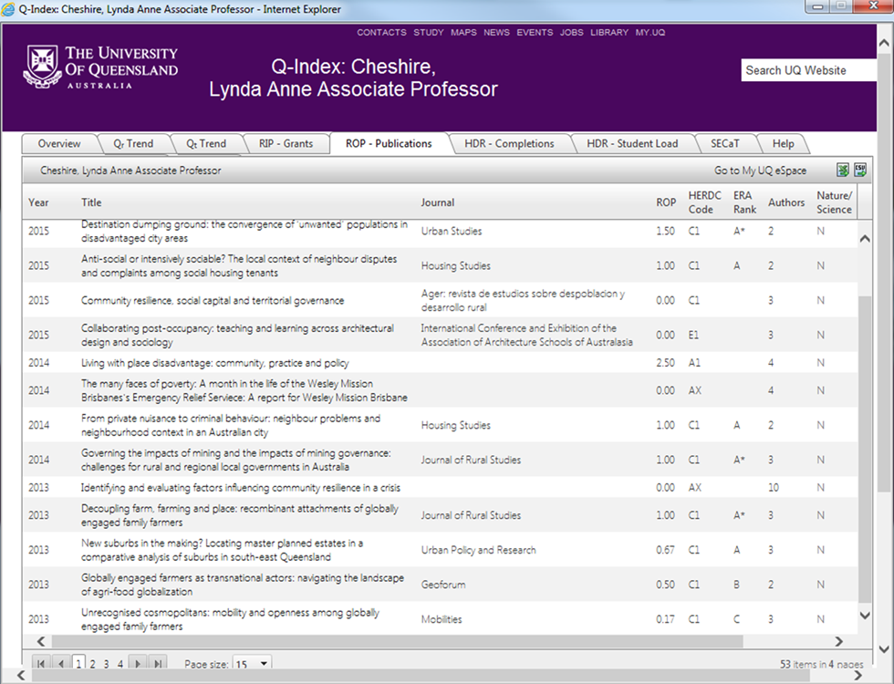
Research Metrics: The Q-Index
Journal of Rural Studies (3 authors) A* journal = 1.00 ROP
Mobilities (3 authors) C journal = 0.17 ROP

Slide 11
BIG DATA AND QUALITATIVE RESEARCH
… a ‘cultural, technological and scholarly phenomenon that rests on the interplay of three things (boyd and Crawford, 2012):
Technology: maximising computational power and algorithmic accuracy to gather, analyze, link, and compare large data sets.
Analysis: using sophisticated techniques to identify patterns in the data.
Mythology: the widespread belief that large datasets offer a higher form of intelligence and knowledge that can generate insights that were previously impossible

Slide 12
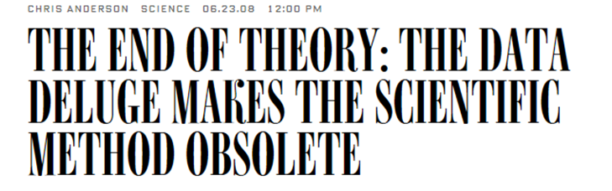
The Challenges of Big Data for Qualitative Research
Naive empiricism: the belief that computational correlations derived from big data speak for themselves, free of human subjectivity
When qualitative research is deployed, it is decoupled from its disciplinary moorings
The social is lost in the analysis
Risk that small studies will be marginalised
Risk of solidifying the quant-qual divide
“This is a world where massive amounts of data and applied mathematics replace every other tool that might be brought to bear. Out with every theory of human behavior, from linguistics to sociology. Forget taxonomy, ontology, and psychology. Who knows why people do what they do? The point is they do it, and we can track and measure it with unprecedented fidelity. With enough data, the numbers speak for themselves” (Anderson, 2008).

Slide 13
The Place of Qualitative Research in Big Data
Big data contains considerable qualitative material which can be used by qualitative researchers to answer questions about the routines, practices, patterns and discourses of social action which have been codified through language.
- E.g. administrative records
Qualitative research provides attention to the ‘practices, routines and activities in and through which ‘patterns’, ‘traces’ and ‘correlations’ (for example) are brought into actual being, in actual settings by actual people’s actions (Smith, 2014: 183).
Big data through administrative records provides opportunities to reach hard-to-access populations
Qualitative research gives rick detail to big data by placing social action within its historical and cultural context: ‘thick data’ for small N research.

Slide 14
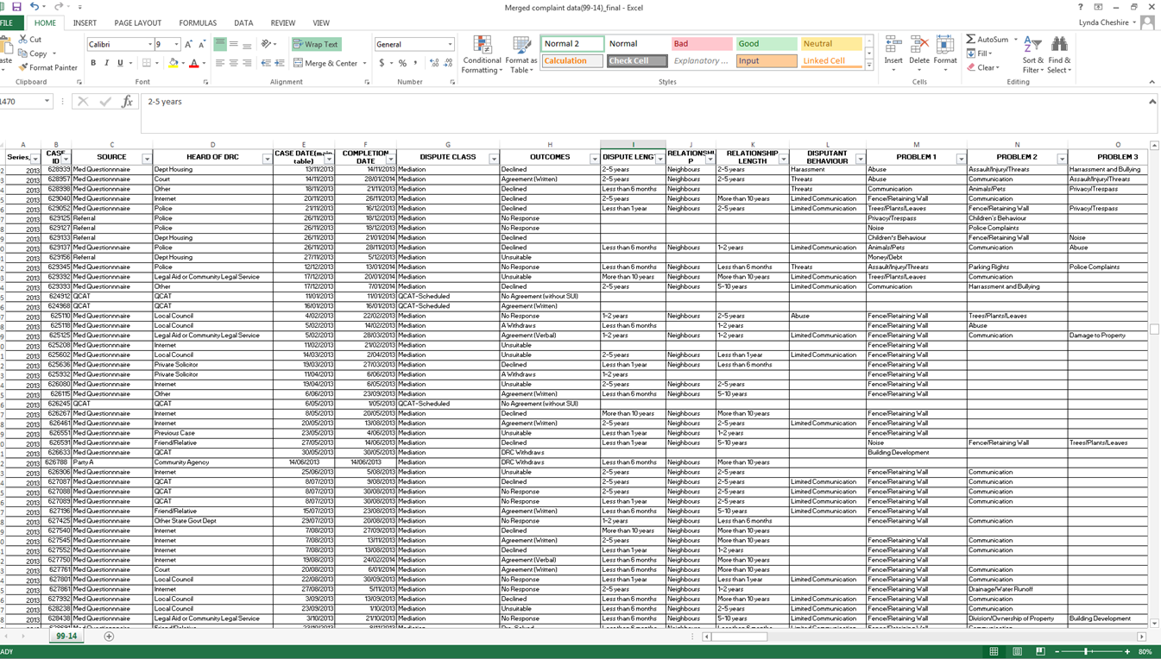
Source: Dispute Resolution Branch, Queensland

Slide 15
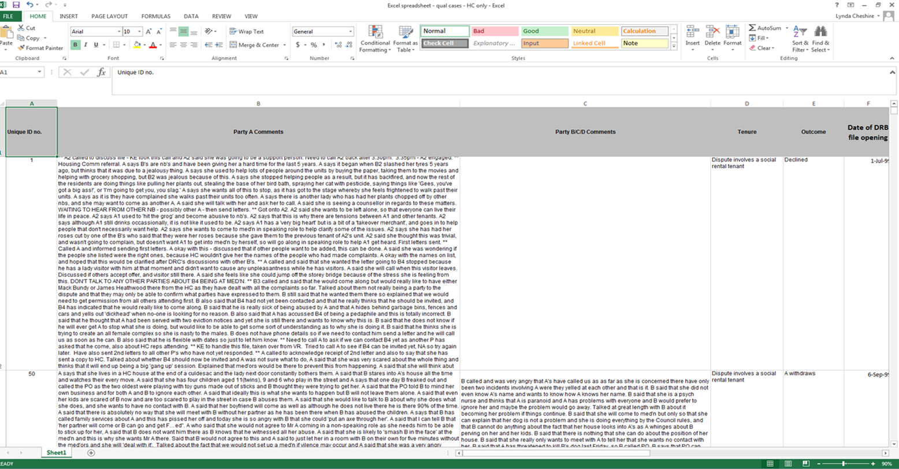

Slide 16
10 ID 91 | Summary Tenants in HC units, Nov-Dec 1999, Palm Beach, 3 parties, RL 2-5years; DL 1 year. Parties agree to mediate but not apparent this occurred A and B used to be friends but when A asked B to keep her children quiet, the relationship turned sour. A says B has been verbally abusive and A1 attests to this. A says she has had a breakdown as a result of the conflict. Parties have consulted the Dept of Housing. B says she feels bullied by A and A1 who write her notes which are never friendly or positive. B says she just wants to live at the units in peace and is presently spending four nights a week at a friend’s house. Mediation questionnaire received - states "(1) lack of consideration to other tenants, noise issues, accusations and lies to the Dept of Housing causing me stress and ill health. (2) Verbal abuse - (A2) has told me personally and I have witnessed (B doing this) (3) Mental health breakdowns since residing this address." A called to say that she had been away for 2 weeks. A said that she used to be friends with B and used to support B through her mental breakdowns. A says that it all started when A asked B's partner of the time to quieten the children down as A was just out of hospital. A says that she no longer had time for B as she became verbally abusive. | B called to accept offer of med'n - B2 says she is frustrated with the situation, as she is feeling bullied by A1 & A2. B says she would like A2's husband to be there also, because she doesn't think he is aware of the situation, and needs his involvement as a member of the units. B says A2 is a shy lady, and is feeling empowered by A1's bullying behaviour. B says A's are writing notes to her in the letterbox and doesn't understand why they can't talk with her face to face about seemingly simple issues. B says the letters she gets are never written in a positive or friendly manner. B says she wants to be able to live at the units in peace, as she is frequently staying at her friends house 4 nights a week. B says she would like to bring support person and will confirm after speaking with her.

Slide 17
The Place of Qualitative Research in Big Data
Big data contains considerable qualitative material which can be used by qualitative researchers to answer questions about the routines, practices, patterns and discourses of social action which have been codified through language.
- E.g. administrative records
Qualitative research provides attention to the ‘practices, routines and activities in and through which ‘patterns’, ‘traces’ and ‘correlations’ (for example) are brought into actual being, in actual settings by actual people’s actions (Smith, 2014: 183).
Big data through administrative records provides opportunities to reach hard-to-access populations
Qualitative research gives rick detail to big data by placing social action within its historical and cultural context: ‘thick data’ for small N research.

Slide 18
Qual 4.0
‘Post-qualitative’ and ‘anti-methodology’ critiques that reject the structures and narratives, such as those of science, that fix , totalise and exclude:
I encourage … [students] to try to forget humanist qualitative methodology and begin with the epistemological and ontological commitments of the analysis – e.g. Derrida’s deconstruction, Foucault’s power-knowledge reading and use it to think about whatever they’re thinking about – dropouts, the Common Core Curriculum, reading. I advise them not to think about their studies using qualitative methodology and its grid of normalizing humanistic concepts, many of which are positivist: ‘problem statement’, ‘research questions’, ‘research design’, interview’, ‘observation’, ‘data’, ‘data collection’, ‘data analysis’, ‘grounded theory’, ‘representation’, ‘systemacity’. Instead, they might ask themselves, for example, how would Foucault study power relations in an educational apparatus in which the concept dropout is possible? What would he do to investigate that problem? (St Pierre, 2014: 10 emphasis in italics).

Slide 19
Three Possible Directions
The deployment of methods that embrace subjectivity, reject linearity of research design and process and emphasise lived experience, including that of the researcher: auto-ethnography, dance, poetry, drama.
The adoption of a more politically activist stance in research. Understanding and interpreting the world is not enough: we need to change it and should not feel obliged to put aside our own values and subjectivities
Rethinking our practice collectively so that our work is conducted and judged by concepts and standards that come from our paradigm and not someone else’s.

Slide 20
REFERENCES
Alasuutari, P. (2010) ‘The rise and relevance of qualitative research’, International Journal of Social Research Methodology, 13(2), 139-155.
Anderson, C. (2008) ‘The end of theory: the data deluge makes the scientific method obsolete’, Wired, 23rd June 2008.
Davidson, J., Paulus, T., Jackson, K. (2016) ‘Speculating on the future of digital tools for qualitative research’, Qualitative Inquiry, DOI 1077800415622505.
Duberley, J. (2015) ‘The future of qualitative research: unity, fragmentation or pluralism?’, Qualitative Research in Organisations and Management: An International Journal, 10(4), 340-43.
boyd, d. and Crawford, K. (2012) ‘Critical questions for big data’, Information, Communication and Society, 15(5), 662-79.
Brinkmann, S., Jacobsen, M. and Kristiansen, S. (2014) ‘Historical overview of qualitative research in the social sciences’, in P. Leavey (ed.) The Oxford Handbook of Qualitative Research, London, Oxford University Press, 17-42.
Geertz, C. (1973) The Interpretation of Cultures: Selected Essays, New York, NY: Basic Books.
Johnson, P. (2015) ‘Evaluating qualitative research: past, present and future’, Qualitative Research in Organisations and Management: An International Journal, 10(4), 320-24.
Kitchen, L. (2013) Big data and human geography: opportunities, challenges and risks’, Dialogues in Human Geography, 3(3), 262-67.
Lather, P. (2013) ‘Methodology 21: what do we do in the afterward?’, International Journal of Qualitative Studies in Education, 26(6), 634-45.
Lather, P. and St Pierre, E. (2013) ‘Post-qualitative research’, International Journal of Qualitative Studies in Education, 26(6), 629-33.
St Pierre, E. (2012) ‘Another postmodern report on knowledge: positivism and its others’, International Journal of Leadership in Education, 15(4), 483-503.
St Pierre, E. (2014) ‘A brief and personal history of post qualitative research’, Journal of Curriculum Theorizing, 30(2), 1-18.
St Pierre, E. (2013) ‘The posts continue: becoming’, International Journal of Qualitative Studies in Education, 26(6), 646-57.
Smith, R. (2014) ‘Missed miracles and mystical connections: qualitative research, digital social science and big data’, in Big Data: Qualitative Approaches to Digital Research Studies in Qualitative Methodology, 13, 181-204.

